Slide 1


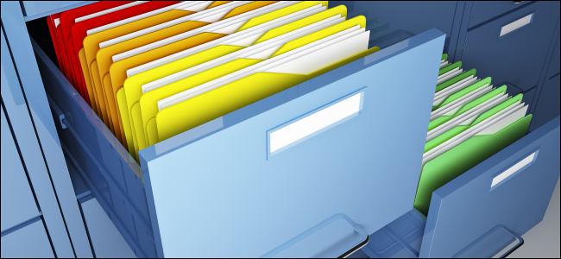

Files and Directories
Manipulating Files
Advanced
C#
SoftUni Team
Technical Trainers
Software University
http://softuni.bg

Slide 2

Table of Contents
File Operations
Directory Operations

Slide 3
Questions
sli.do #9177

Slide 4
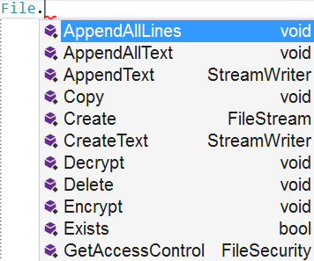
File Class in .NET
Easily Working With Files

Slide 5
Using the File Class
Input operations
ReadAllText() – reads everything at once and returns a string
ReadAllLines() – reads line by line and returns a collection
Output operations
WriteAllText() – takes a string and writes it to a file
WriteAllLines() – takes a collection and writes every element on a new line

Slide 6
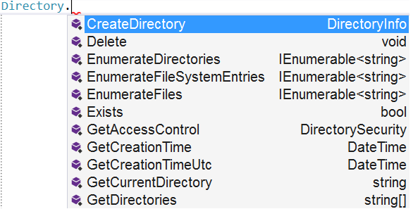
Directory Class in .NET
Easily Working With Directories

Slide 7
Directories
CreateDirectory() – creates the directory and all subdirectories at the specified path, unless they already exist
Delete() – deletes an empty directory
Move() – moves a file or directory to a new location

Slide 8
Directories(2)
GetFiles() – returns the names of files (including their paths) in the specified directory
GetDirectories() – returns the names of subdirectories (including their paths) in the specified directory

Slide 9

Summary
You can use the File class to create/modify/delete files
You can use the Directory class to create/delete/iterate over directories

Slide 10








Files and Directories
https://softuni.bg/courses/advanced-csharp

Slide 11






Free Trainings @ Software University
Software University Foundation – softuni.org
Software University – High-Quality Education, Profession and Job for Software Developers
softuni.bg
Software University @ Facebook
facebook.com/SoftwareUniversity
Software University @ YouTube
youtube.com/SoftwareUniversity
Software University Forums – forum.softuni.bg

